Slide 1
P8: Optional Preliminary Formatting

Slide 2
Preliminary Formatting
Sometimes, the change of the files (resaving) before TxtShuffle / Nematicity (AveragedRot) is required. Some possible cases are:
  Some individual scans have high noise \ unphysical features (AverageOverScansT helps with it)
  Temperature –dependent measurement set (manual, old program versions) with different increment (CloneAndRenumber helps with it)

Slide 3
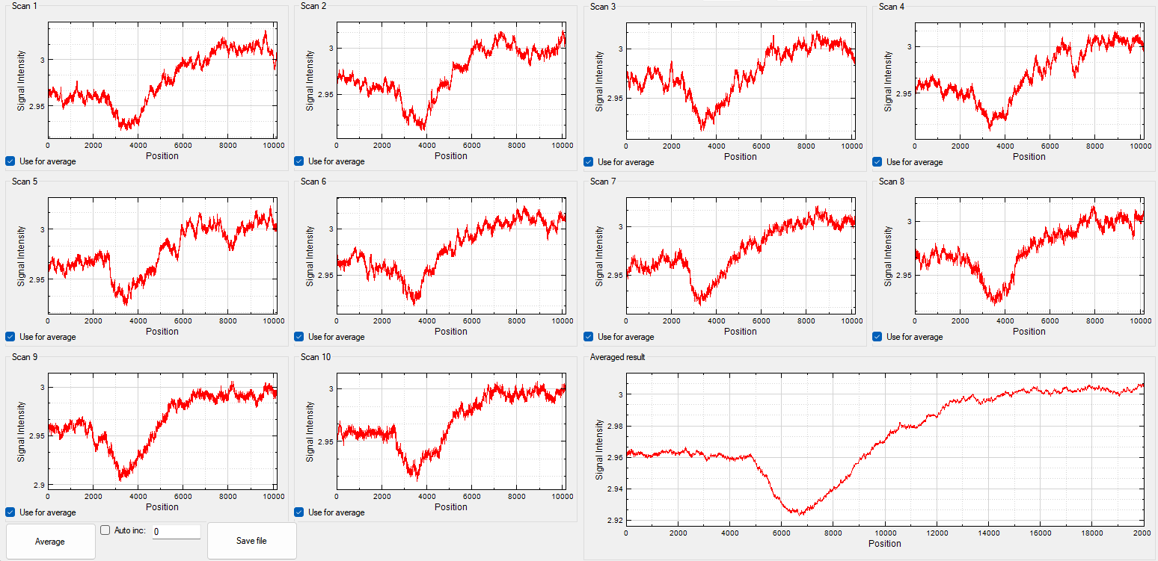
What AverageOverScansT does
Some scans have features, caused by the measurement systems (unreliable peaks, oscillatory-like noise, power instability). These individual scans can skew the averaged scan, if the number of scans is low.
AverageOverScansT allows to remove these individual scans from the resulting averaged file.
Video explanation is given in the video AverageOverScansT

Slide 4
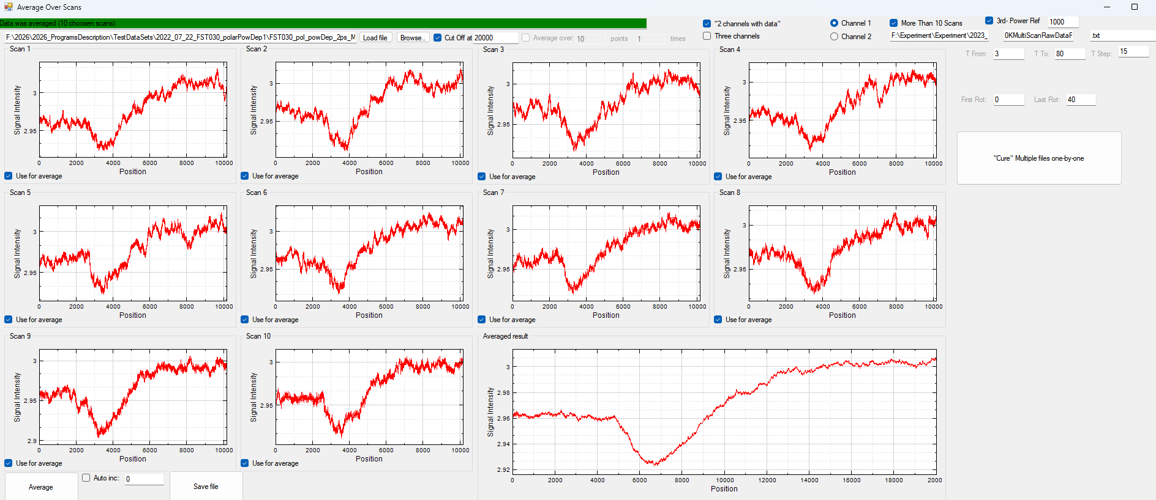
Overview of the MainWindow
Next sections are highlighted by different colorboxes:
Files Path to file (Data /RawDataRot should be used)
Individual Scans (which channel to show if applicable, which scans are used for averaging)
The result of the averaging
Save Files
Revase AveragedRot (“cure” – stand for the case when there is a bug in AveragedRot AND Data files, but no issue with RawDataRot files). Redundant feature, that was developed due to edge-case bug in the exmperimental program.
Video explanation is given in the video AverageOverScansT

Slide 5
Main Workflow (AverageOverScansT)
Select the file (using Browse button). Set the correct number of channels.
Uncheck “use for average” of undesired scans
“Average” then Save file.
Video explanation is given in the video AverageOverScansT
1
2
3

Slide 6
What CloneAndRenumber does
Both TxtShuffle and Nematicity expect equidistant data (same increment), and the same increment is required for IgorPro.
CloneAndRenumber clones the measurements files to ensure that all data is equidistant.
Video explanation is given in the video CloneAndRenumber

Slide 7
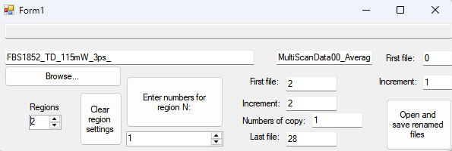
Overview of the MainWindow
Next sections are highlighted by different colorboxes:
Files Path to files, split according to temperature dependent measurement rules (as explained in P1)
Settings for the different temperature region
Setting for cloning of the files
Video explanation is given in the video CloneAndRenumber

Slide 8
Overview of the MainWindow
Select the file (using Browse button). Fill the text boxes correctly (first – prefix, counter should be omitted, suffix – second textbox).
Set the number of regions with different increments.
Set the cloning rules for every region.
4) Set the counting rules for cloned files (usually, leave default 0 first file, 1 increment, can be changed). Click “Open and Save”.
Video explanation is given in the video CloneAndRenumber
1
4
3
2

