Slide 1
P7: Introduction to using IgorPro

Slide 2
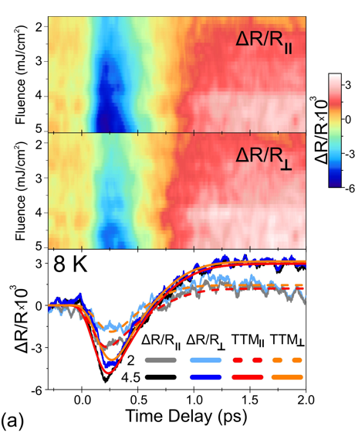
IgorPro Load Data overview
To load data in IgorPro, the data should be organized as a 2D table with equidistant points (both axes). IgorPro needs to know the first and the last points for both axes. This information is coded in the file names:
For example: ;q=-0.450000;X=1.53260;s=1.5945;Y=7.9726;T=8 K;.txt
q – the first X value (usually, first time delay value), X – last X value (usually, last time delay value). s- the first Z value (lowest Power /Fluence or first temperature), Y - the last Z value (highest Power /Fluence or last temperature) T – optional label
Top and middle 2D maps as an example
of IgorPro plotting capabilities

Slide 3
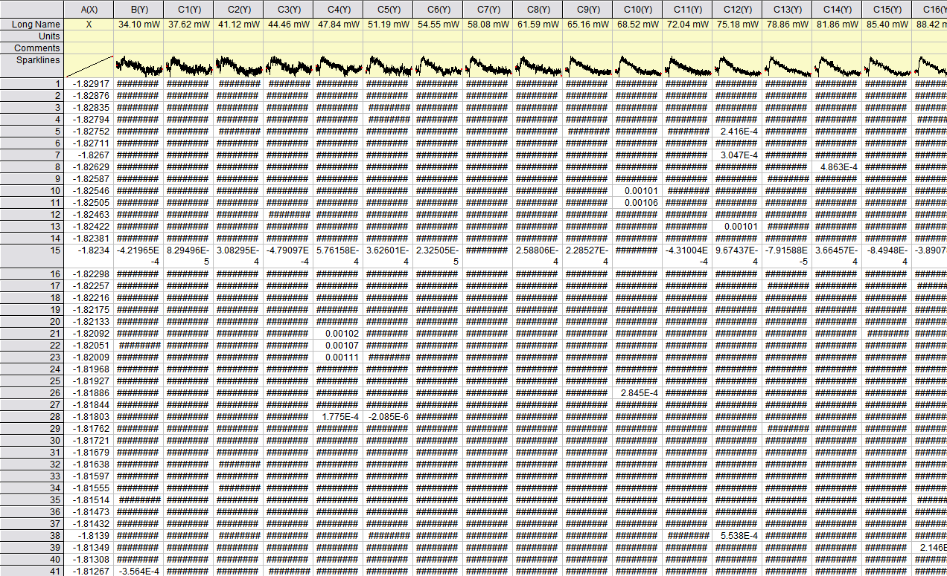
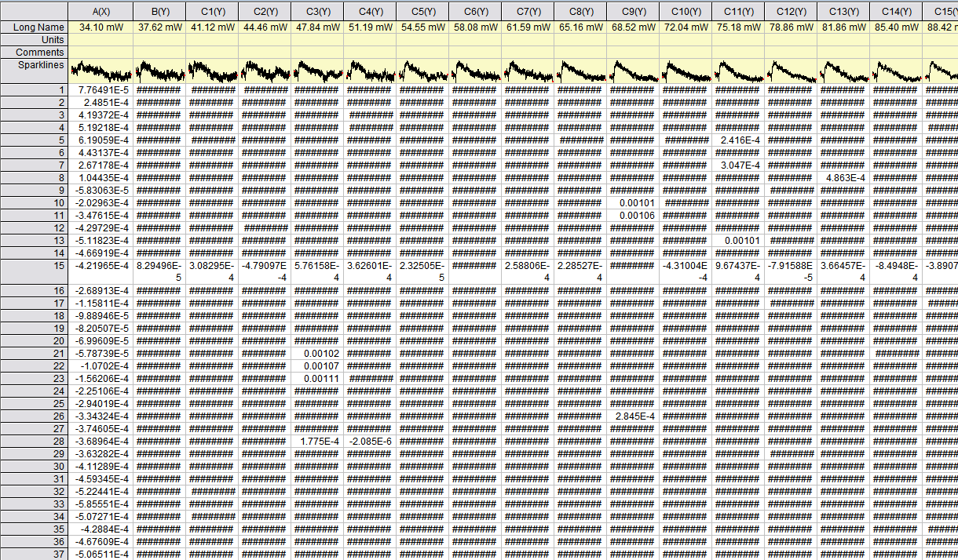
Most programs are capable of saving the data tables with no X and with the correct filename for IgorPro specifically
“withX” (for Origin / C# Analysis Programs)
“no X” (for IgorPro)

Slide 4

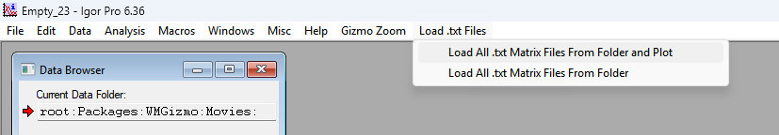
Empty_23 – template that consists the necessary routine
Empty_23 template consists of code to load ALL txt files from the selected folder and plot them as a 2D Image, as well as optional “SmoothWave” function.
ONLY Load … and Plot works correctly! Load … (no Plot) does not work.
Video explanation is given in the video
IgorProOverview

Slide 5
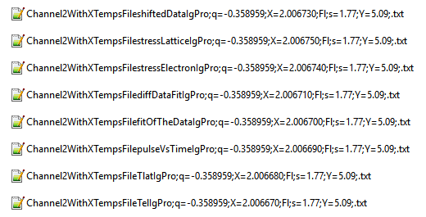
Important note!
If two files are in the same folder to be opened by IgorPro, have the same first \ last X AND Z values, IgorPro cannot distinguish them upon opening, so it will OVERWRITE one file. For that reason, negligible shifts (+0.0000n) are used to distinguish between the file types if needed to open more than one.
This is the case for TTM files, for example.
Video explanation is given in the video
IgorProOverview
Here, there is slight added difference to X values
to make sure IgorPro will distinguish these files

