Slide 1
Advanced Analysis (EtaMin, renormalization using Two Temperature Model)

Slide 2
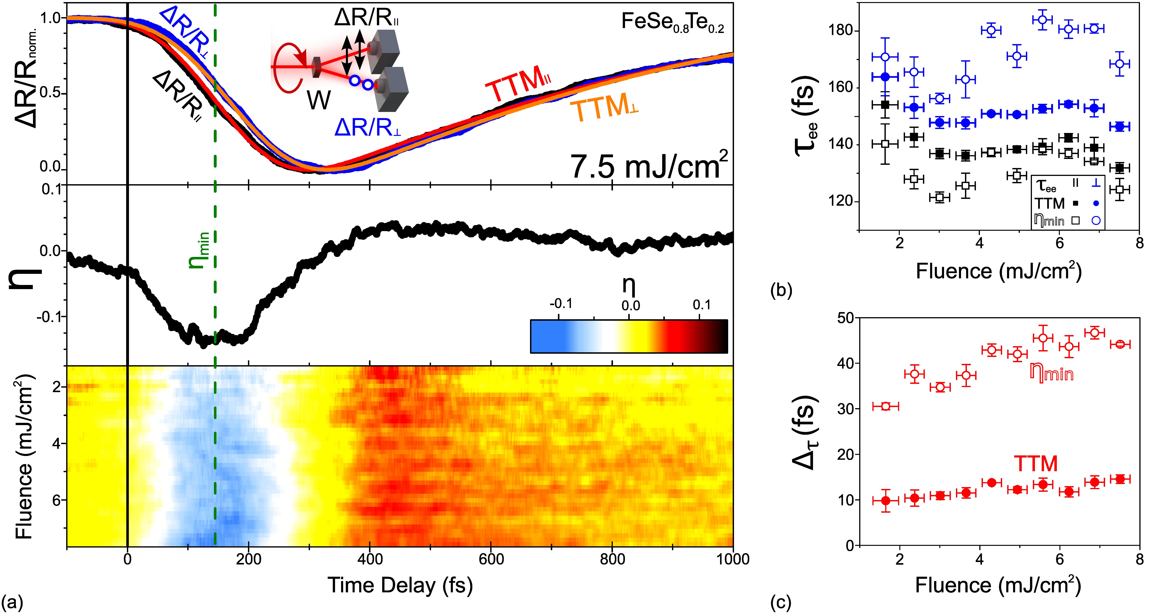
The main idea of the program – to renormalize exp data based on the minimum position, obtained for that data from its TTM fit
Program uses the fact that 1)TTM fits the data fairly well 2)TTM is noise-free. Based on 1) and 2), the minimum in TTM corresponds to the minimum in exp data. Then, the data is renormalized 0 – 1 (0 at min, 1 at negative time delay) no obtain normalized nematic function η, and to estimate thermalization times from it (for more details https://arxiv.org/pdf/2602.05771)

Slide 3
Preparation of the files (prerequisites)
Two channels output from Nematicity.
TTM (FitOfTheData) for BOTH channels.
Ideally, all in one folder.

Slide 4
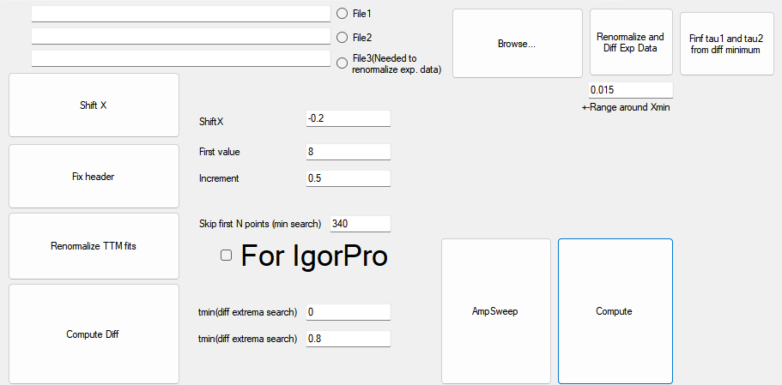
Overview of the MainWindow
Next sections are highlighted by different colorboxes:
Files path, same for all tasks.
Renormalization / Difference of TTM Fits.
Renormalization / Difference of Exp Data
Tau1 / Tau2 routine from minimum in difference

Slide 5
Part 1:Renormalization / Difference of TTM Fits
1
Choose two files: File 1 :Channel 1 TTM fit (fitOftheData), File 2: Channel 2 TTM fit.
(Optional) Shift X if needed, fix header if needed
Renormalize TTM fits (click the button)
Compute Diff(click the button)
Video explanation is given in the video EtaMinRoutine
2
3
4

Slide 6
Part 2:Renormalization / Difference of Exp Data
1
2
Choose THREE files: File 1 :Channel 1 Exp Data, File 2: Channel 2 Exp Data. (Output files of Nematicity program), File 3: “prerenorm_summary” file from Part 1.
Renormalize and Diff Exp Data(click the button)
Video explanation is given in the video EtaMinRoutine

Slide 7
Part 3 (optional):
1
2
Choose ONE files: File 1 : “diff_summary” file from Part 1.
Find tau1 and tau2 from diff minimum(click the button)
Video explanation is given in the video EtaMinRoutine

