Slide 1
Basic Analysis Programs (MinMaxSearch, CrossSec, GetTheTau)

Slide 2
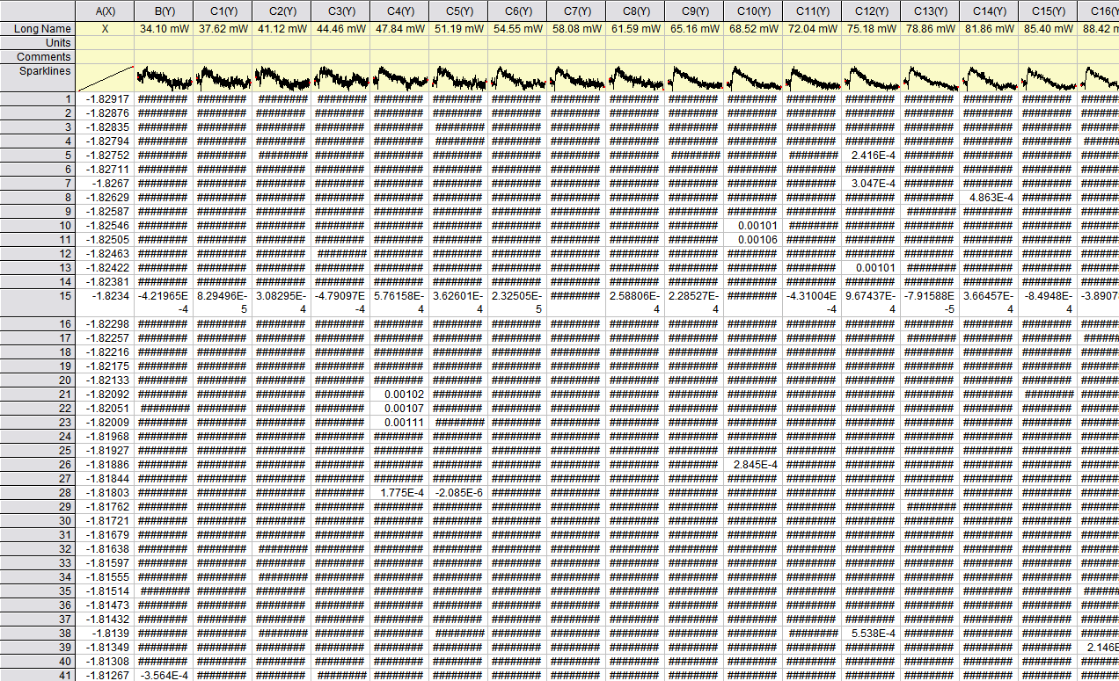
Input format
These programs expect the input file to be in the format of output of TxtShuffle / Nematicity programs. Additionally, the Two Temperature Model output files (with X) have the same format and can be analyzed using these programs.

Slide 3
MinMaxSearch Overview
MinMaxSearch searches for minimum position and the value of transient signal in the minimum, across entire power or temperature-dependent measurement set.
Input
Output

Slide 4
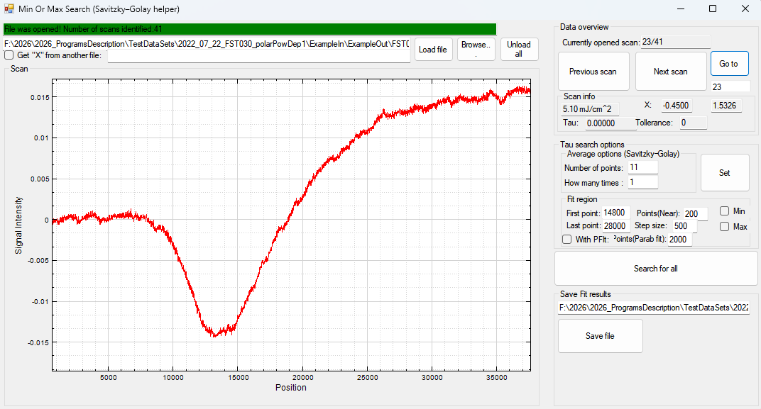
MinMaxSearch Main Workflow
Load the file.
Select the Search Region (in the point numbers!),filter and search values.
Click “Seach for all”.
Set the desired file name (with the cross sections). Click “Save file”.
Video explanation is given in the video MinMaxSearchGuide
1
2
3
4

Slide 5
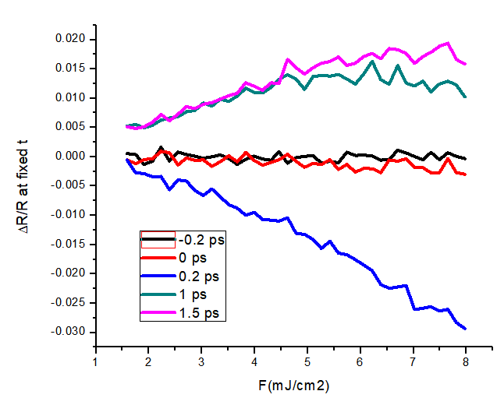
CrossSec Overview
CrossSec generates the power \ fluence dependence of transient signal at given times.
Input
Output

Slide 6
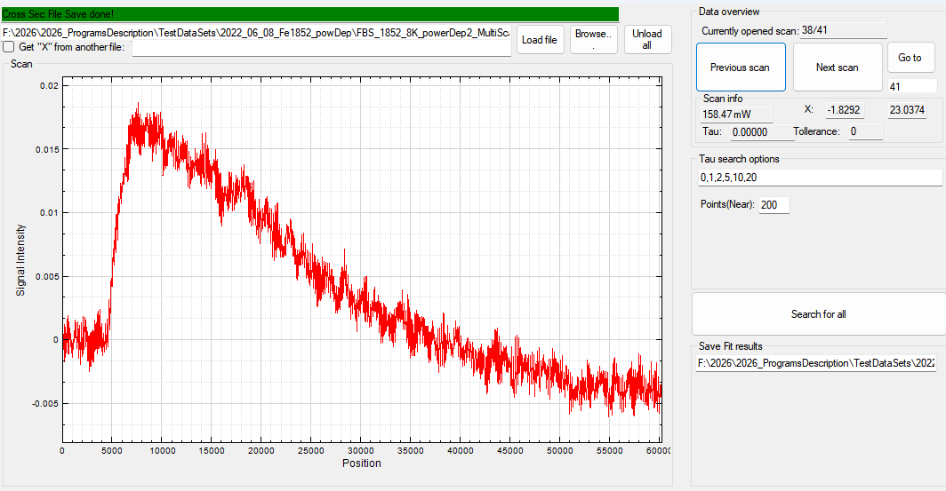
CrossSec Main Workflow
Load the file.
Select the time positions in the units of X axis, not point numebrs!), and how many neighbours to use to get cross section \ averaged value.
Set the desired file name (with the cross sections).
Click “Search for all”.
Video explanation is given in the video CrossSecGuide
1
2
4
3

Slide 7
GetTheTau Overview
GetTheTau fits the transient signal using 1 or 2 Decaying exponent functions.
Origin Non-linear fit is better overall. This program can be used for quick preliminary results \ tests.
Input
Output

Slide 8
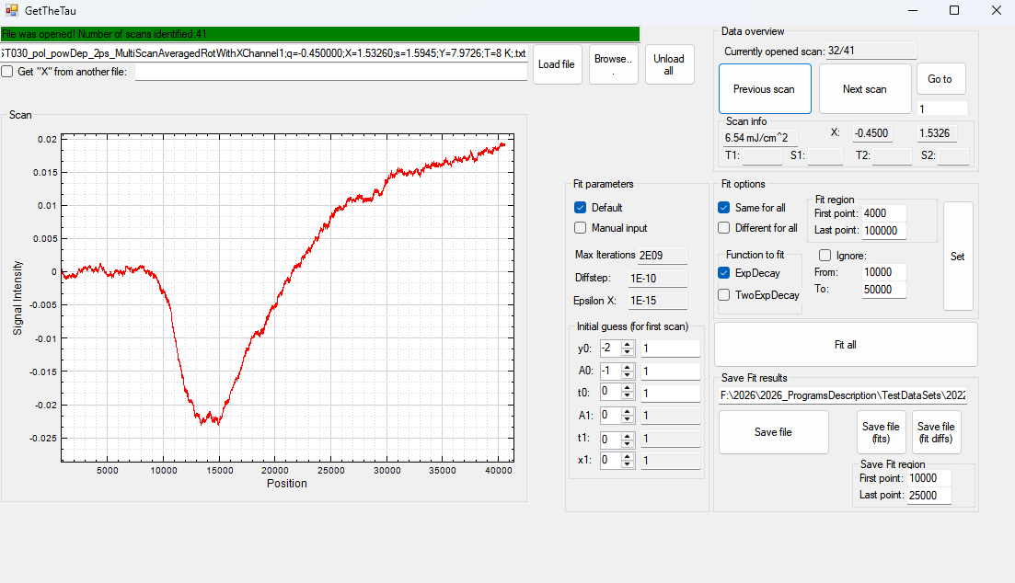
GetTheTau Main Workflow
Load the file.
Select the correct fit region, if applicable, set the region that will be ignored (not used) during the fit, click SET.
Click “Fit all”.
Save all desired fit files (parameters from fit – Save File, Fits – Exp decay functions, Fit diffs – Data-Exp decay functions)
Video explanation is given in the video GetTheTauGuide
1
2
3
4

