Slide 1
One channel measurement processing using TxtShuffle ( or TextShuffleByT)

Slide 2
Preparation of the files
Files should be in one folder. They should have one clear “counter” N: for example, [prefix]RotN.txt in case of Power dependent measurement sets or [prefix]_N[suffix].txt.
User should know the number of data points to choose to idendify the zero baseline, as well as shift of the zero-time position.
User should know the reference power or temperature.

Slide 3
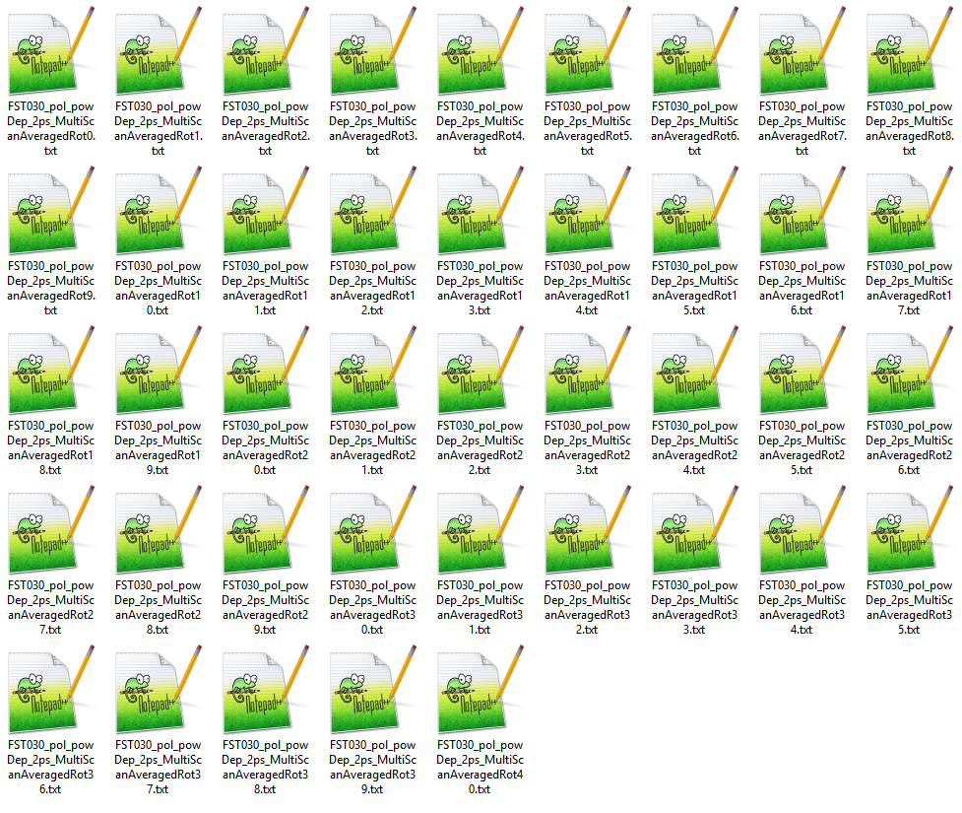
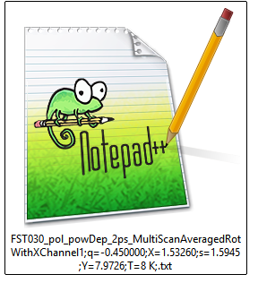
The main idea of the program -Equidistant Interpolation (to combine all scans from one measurement set into a 2D Map), done by TxtShuffle and Nematicity
Each scan has its own set of positions due to the continuous nature of recording. For a correct plotting (especially important for maps), all separate scans.
The goal of these programs is to:
Reorganize the data is a more useful format (S[t,P] or S[t,T] table)
Initial treatment of the data (renormalize, shift zero, attach the correct power \ temperature labels)
1 file*, S_{ij}[t] with same equidistant time axis t
N files, S_{i}[t_{i}] with different time axes t_{i}
*1 file for 1 ch measurements / 3 main files for 2 ch measurements

Slide 4
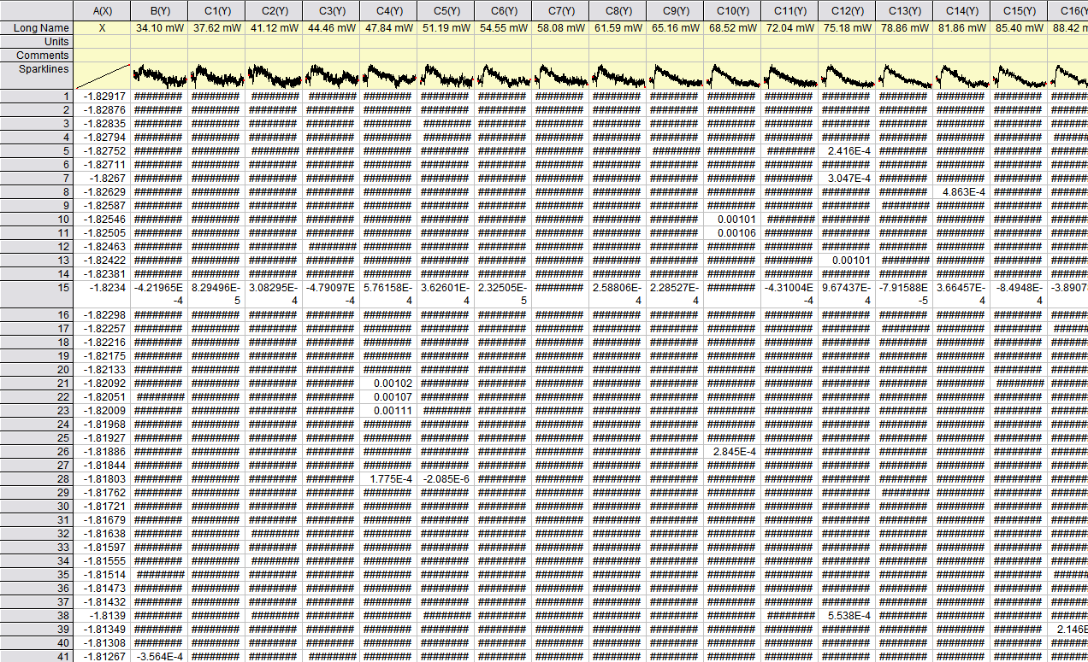
Typical format of output of TxtShuffle \ TextShuffleByT
One output table has 1 time delay (X) coloumn (common time coloumn for all scans), as well as all M scans data (Y), labeled with the correct power \ temperature (Z)

Slide 5
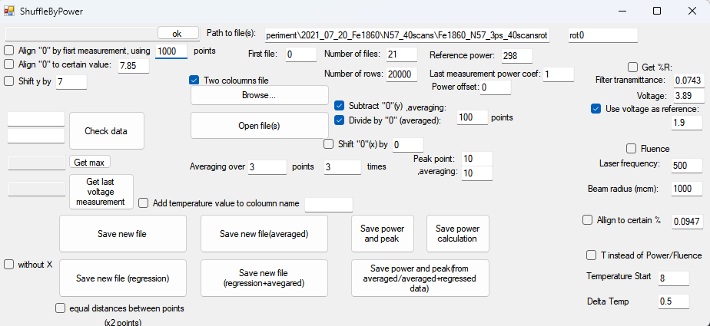
Overview of the MainWindow
Colour boxes show which UI elements impact corresponding axis (X,Y,Z) in the output table.
Detailed explanation of all UI elements is given in the video TxtShuffleOverview

Slide 6
Main Workflow (Power Dependent Measurements)
Select any “AveragedRot” file (two-coloumn file should be ON!)
Change the Path to file, so the first textbox is suffix, and the second textbox is suffix (Empty in case of power dep measurements!).
Enter the first file counter, and number of files.
Enter the power information (convert to fluence if needed)
Choose the processing option (R, dR, dR/R). Align “0” by first measurement to reduce the “parasitic signal” from “pump”.
If needed, shift “0” time delay position.
Open files (during the opening, premilinary processing happens.
Choose with or without X ( without - for IgorPro). Equal distances – equidistant regression – should be ON! Click “Save new file (regression).
Video explanation is given in the video TxtShufflePowerRoutine
2
5*
3
4
1
5
4*
7
6
4**
8

Slide 7
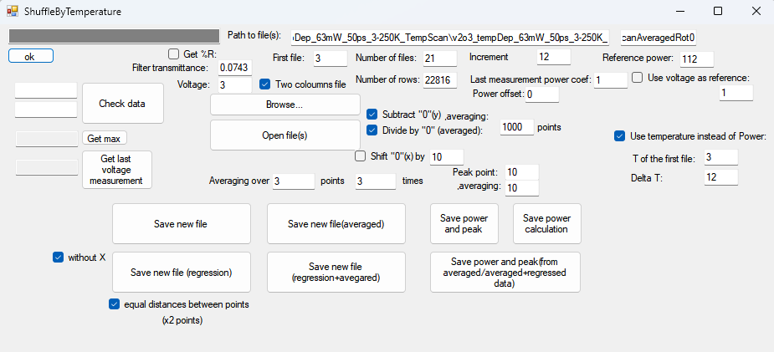
Main Workflow (Temperature Dependent Measurements)
Select any “AveragedRot” file (two-coloumn file should be ON!)
Change the Path to file, so the first textbox is suffix, and the second textbox is suffix (without .txt).
Enter the first file counter, and number of files.
Enter the temperature information
Choose the processing option (R, dR, dR/R). Align “0” by first measurement to reduce the “parasitic signal” from “pump”.
If needed, shift “0” time delay position.
Open files (during the opening, premilinary processing happens.
Choose with or without X ( without - for IgorPro). Equal distances – equidistant regression – should be ON! Click “Save new file (regression).
Video explanation is given in the video TxtShuffleTempRoutine
2
3
1
5
7
4
6
8

