Slide 1
P1: Introduction into the Experimental Measurements Programs working principle and output

Slide 2
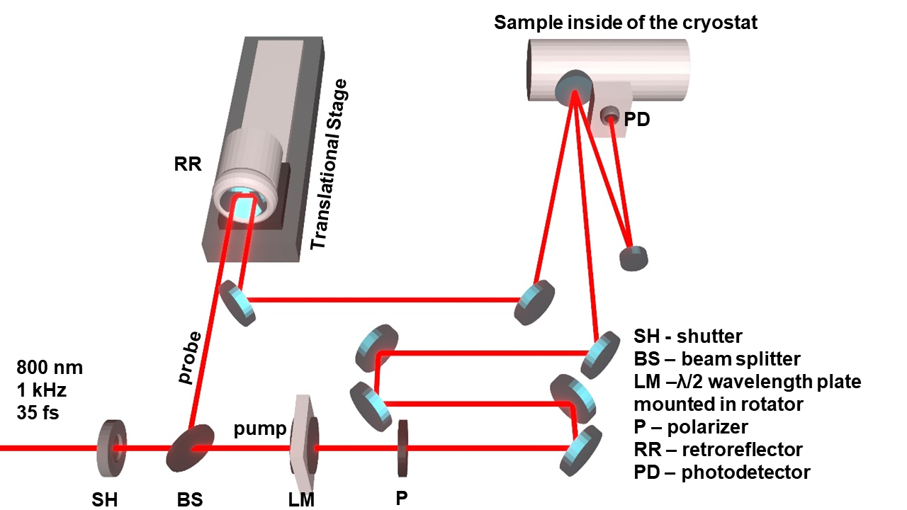
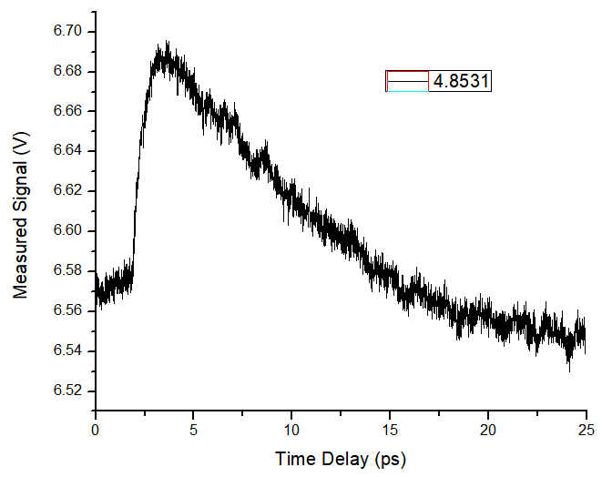
Example of transient signal S(t)
One measurement stands for one transient signal S(t). In this example, transient reflectivity was measured, but the presented guide will work for ANY transient signal.
Experimental programs allow measurement at controlled temperature T and power P, therefore there are two main types of measurements: temperature-dependent measurements (at fixed P, changing T), and power-dependent measurements (at fixed T, changing P)

Slide 3
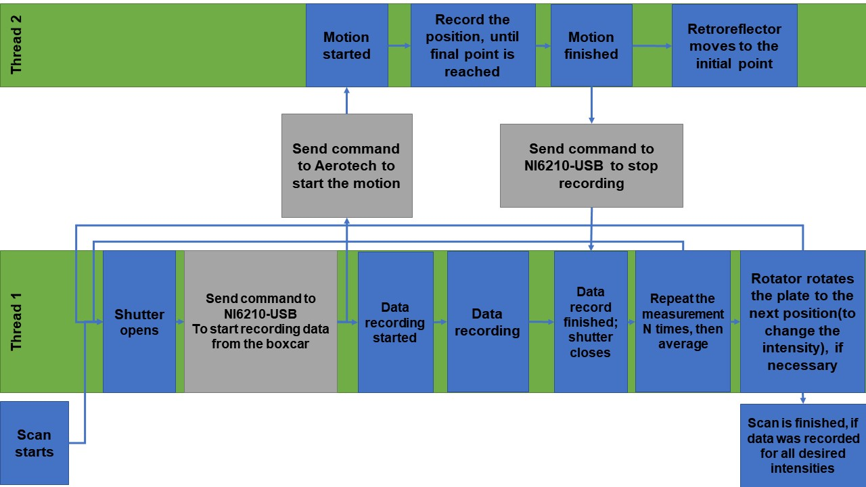
Measurement Program Working Principle (Multiscan)
Measurement programs use two separate threads for data (signal from the photodetector) and position recording.
The hardware connection is summarized on the extra slide 1.

Slide 4
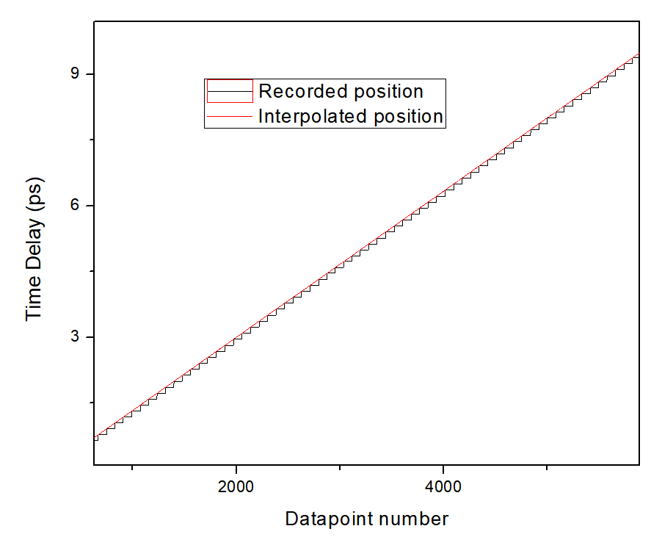
Initial Interpolation (for each Multiscan separately)
Position recording is SLOWER that the data recording, each scan position values are interpolated linearly based on the data recording.

Slide 5

Multiscan
Generally, scan is repeated several times at the same T and P, and then averaged, to increase Singal-To-Noise ratio.
For all separate scans within one multiscan, the data is averaged into a one scan, and saved as a file with “AveragedRot” suffix.
All three types of files are summarized in the extra slides 2-4.
Data / RawDataRot
AveragedRot

Slide 6
Measurement Sets
One measurement set: M multiscans (each resulting in one Averaged scan – AveragedRot files –files to use in TxtShuffle / Nematicity).
All three types of files are summarized in the extra slides 2-4.

Slide 7
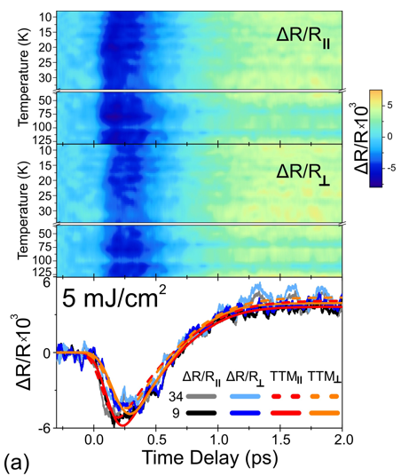
Temperature Dependent Measurements
Temperature-dependent measurement sets represent transient-signal data recorded as a function of both time delay and sample temperature, S(t,T). In this case, the regular format of the names of the output files is: [prefix]+[Temperature\temperature counter]+[suffix].txt
For example:v2o3_tempDep_63mW_50ps_3-250K_30KMultiScanAveragedRot0.txt
Note that 30 here stands for 3.0K, not 30K due to temperature coding into the filename

Slide 8
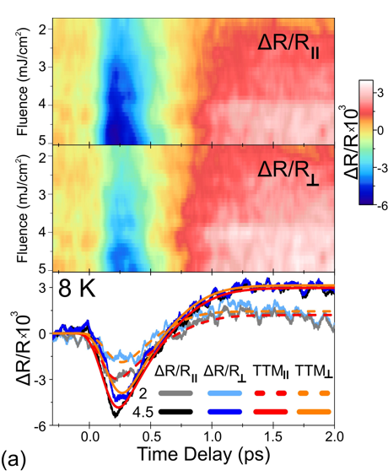
Power Dependent Measurements
Power-Dependent measurement sets are S(t,R). Achieved by rotating the haflwavelength plate, hence the power is defined by the rotation position N, or RotN.
In this case, the regular format of the output files is: [prefix]+[RotationCounter].txt
For example: FST030_pol_powDep_2ps_MultiScanAveragedRot40.txt

Slide 9
What initial processing programs do
Other then combining the entire set into one table, initial processing also includes recalculation of the transient signal into a relative change. It can be done with TxtShuffle or Nematicity, as explained in P2 and P3.

Slide 10
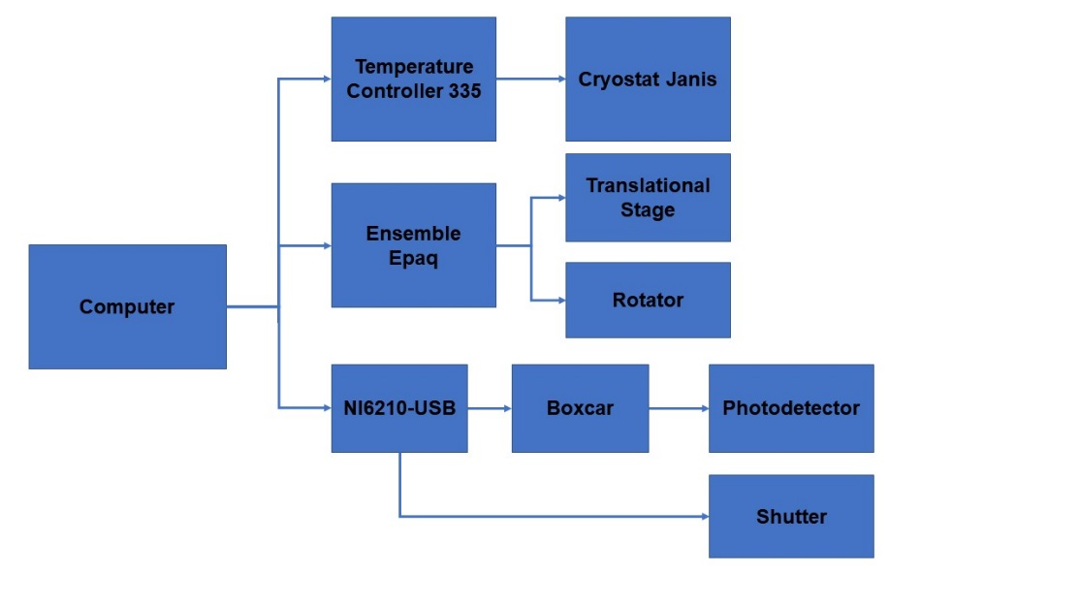
Extra Slide 1. Hardware Connection
Programs control the time delay t by controlling the Translational Stage, the power P by controlling the rotator (by rotting the halfwavelenghtplate), and the temperature T.

Slide 11
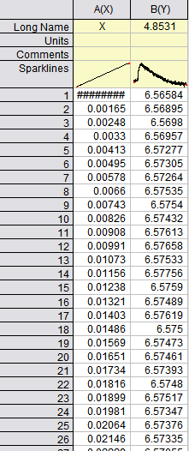
Extra Slide 2. “AveragedRot” Files
AveragedRot –consists inverpolated translational stage position X for the averaged scan, followed bymeasured channels (1 or 2 depending on single channel of two channel measurements).
If applicable – header of the second coloumn (data Ch1) is the average over the reference channel, can be used in TxtShuffle.
These files should be primarily used in TxtShuffle or Nematicity.

Slide 12
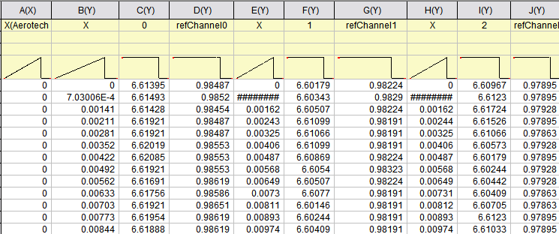
Extra Slide 3. “RawDataRot” Files
RawDataRot0 –consists real recorded translational stage positions (X(Aerotech)) for the first scan, interpolated translational stage positions (X) for each scan, followed by all measured channels.(Ch1, power reference) for single channel measurements or (Ch1, Ch2 , power reference) for two channel measurements.
These files serve as a “backup” if there is an issue with any of individual scans (during one Multiscan) or there was an error in processing “AveragedRot” file by the measurement program.

Slide 13
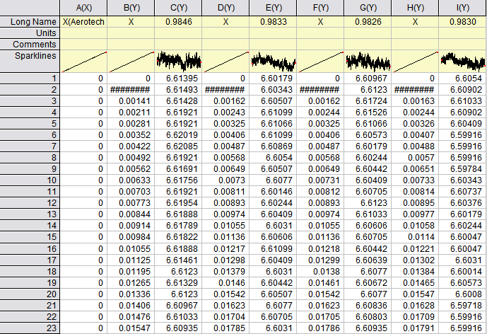
Extra Slide 4. “Data” Files
“Data” file consist real recorded translational stage positions (X(Aerotech)) for the first scan, interpolated translational stage positions (X) for each scan, followed by measured Ch1, with the header being the average of the next (reference, Ch2) channel.
These files have the data from RawDataRot, used to obtain AveragedRot, and are recorded for diagnostical reasons: If there is an issue with processing “AveragedRot” file, one can examine “Data” file to ensure the measurement program did not omit any data.
Single channel measurement example

