Slide 1
Data Processing of Transient Signals. Overview

Slide 2
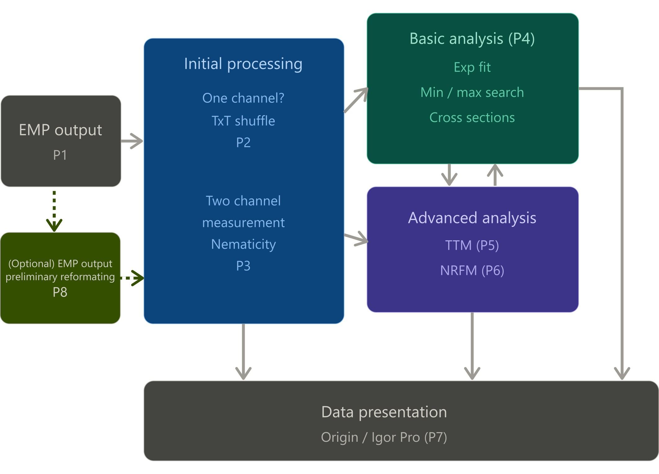
Summary of the Workflow
P1 explains the structure of the experimental measurement programs (EMP) and the types of the output files.
P2 / P3 explain how to combine the measured transient signals into one convenient txt table, to work with the rest of the programs.
P4 shows the basic possible analysis with this txt table.
P5 /P6 show how to use Two Temperature Model (TTM) or to apply NRFM based on the TTM fit.
P7 shows how to plot the data using IgorPro template and what are the file organization \ naming rules.

Slide 3

P1 Summary
For all separate scans within one multiscan, the data is averaged into a one scan, and saved as a file with “AveragedRot” suffix.
One measurement set: M multiscans (each resulting in one Averaged scan – AveragedRot files –files to use in TxtShuffle / Nematicity).
Temperature-dependent measurement sets represent transient-signal data recorded as a function of both time delay and sample temperature, S(t,T). In this case, the regular format of the names of the output files is: [prefix]+[Temperature\temperature counter]+[suffix].txt
For example:v2o3_tempDep_63mW_50ps_3-250K_30KMultiScanAveragedRot0.txt
Power-Dependent measurement sets are S(t,R). Achieved by rotating the haflwavelength plate, hence the power is defined by the rotation position N, or RotN.
In this case, the regular format of the output files is: [prefix]+[RotationCounter].txt
Video explanation is given in the video IntroPrograms
Data / RawDataRot
AveragedRot

Slide 4
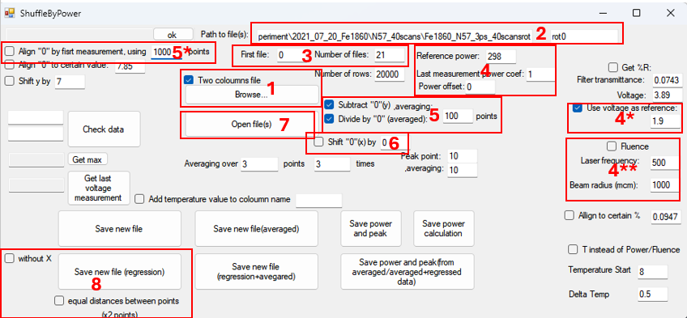
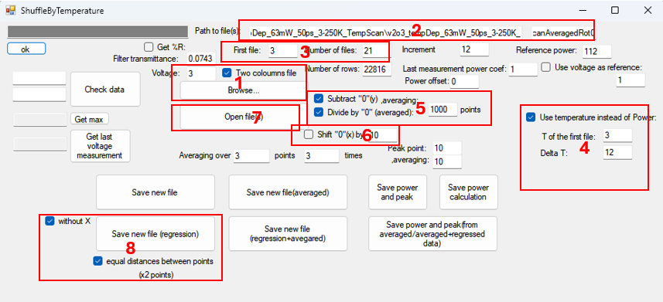
P2 Summary
TxtShuffle / TextShuffleByT is used to combine all AveragedRot files (transient signals) from one Power / Temperature measurement set into one data table with the same equidistant time delay.
Works for single channel measurement sets.
Video explanations are given in the videos
TxtShuffleOverview
TxtShufflePowerRoutine
TxtShuffleTempRoutine

Slide 5
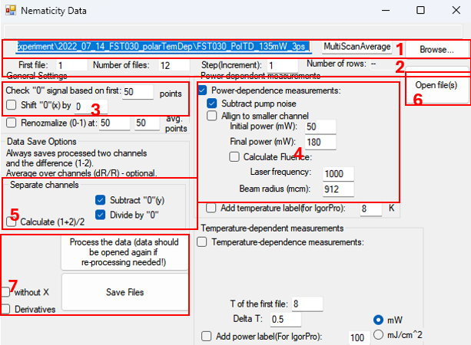
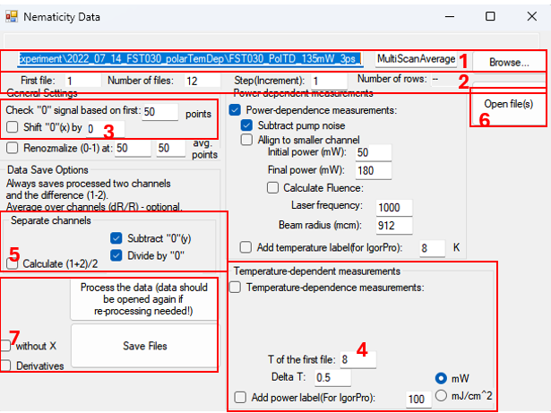
P3 Summary
Nematicity is used to combine all AveragedRot files (transient signals) from one Power / Temperature measurement set into one data table with the same equidistant time delay.
Works for two channel measurement sets.
Video explanations are given in the videos
NematicityOverview
NematicityPowerRoutine
NematicityTempRoutine

Slide 6
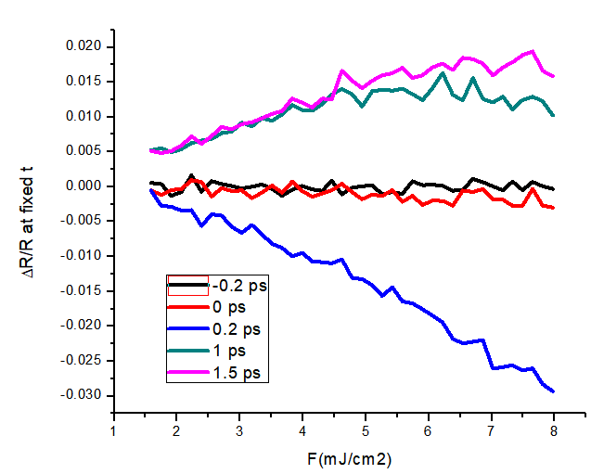
P4 Summary
MinMaxSearch searches for minimum position and the value of transient signal in the minimum, across entire power or temperature-dependent measurement set.
CrossSec generates the power \ fluence dependence of transient signal at given times.
GetTheTau fits the transient signal using 1 or 2 Decaying exponent functions.
Video explanations are given in the videos
MinMaxSearchGuide
CrossSecGuide
GetTheTauGuide
Input
MinMaxOutput
CrossSec Output
GetTheTauOutput

Slide 7
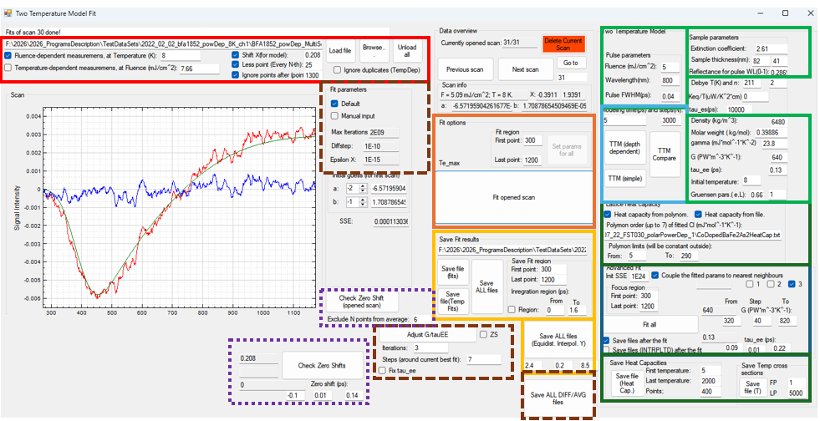
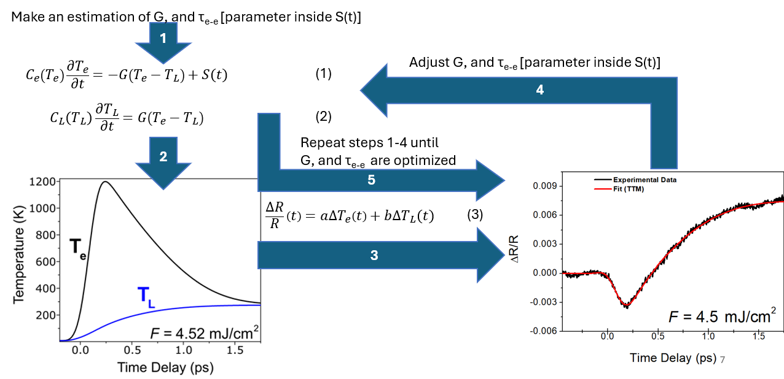
P5 Summary
Two Temperature Model (TTM) Fit is used for the automatic or manual fit of the transient data, as well as depth-dependent TTM calculations.
Video explanations are given in the videos
TTMPrerequisites
TTMOverview
TTMFirstManualScans
TTMAdvFitRoutine
TTMDepthDependent

Slide 8
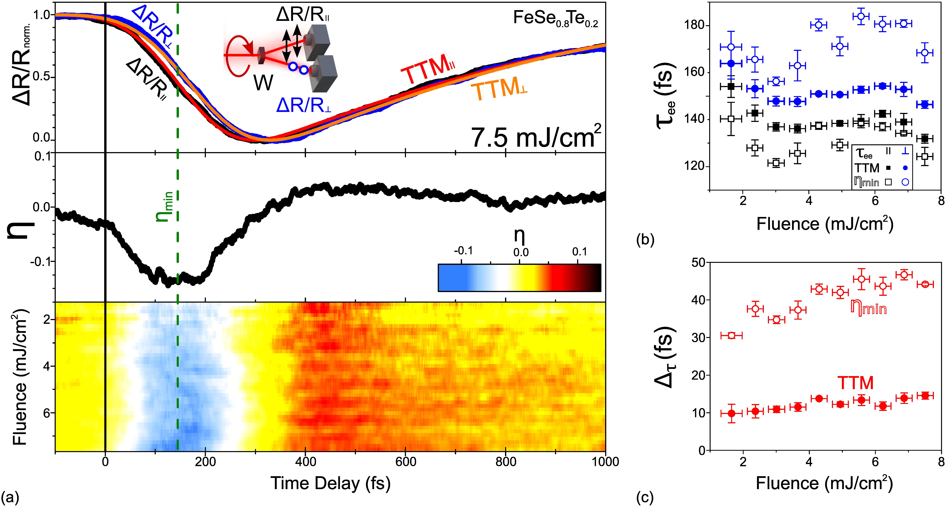
P6 Summary
Program uses the fact that 1)TTM fits the data fairly well 2)TTM is noise-free. Based on 1) and 2), the minimum in TTM corresponds to the minimum in exp data. Then, the data is renormalized 0 – 1 (0 at min, 1 at negative time delay) no obtain normalized nematic function η, and to estimate thermalization times from it (for more details https://arxiv.org/pdf/2602.05771)
Video explanation is given in the video EtaMinRoutine

Slide 9

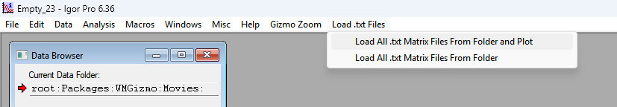
P7 Summary
To load data in IgorPro, the data should be organized as a 2D table with equidistant points (both axes). IgorPro needs to know the first and the last points for both axes. This information is coded in the file names:
For example: ;q=-0.450000;X=1.53260;s=1.5945;Y=7.9726;T=8 K;.txt
q – the first X value (usually, first time delay value), X – last X value (usually, last time delay value). s- the first Z value (lowest Power /Fluence or first temperature), Y - the last Z value (highest Power /Fluence or last temperature) T – optional label
Empty_23 template consists of code to load ALL txt files from the selected folder and plot them as a 2D Image, as well as optional “SmoothWave” function.
ONLY Load … and Plot works correctly! Load … (no Plot) does not work.
Video explanation is given in the video
IgorProOverview

Slide 10
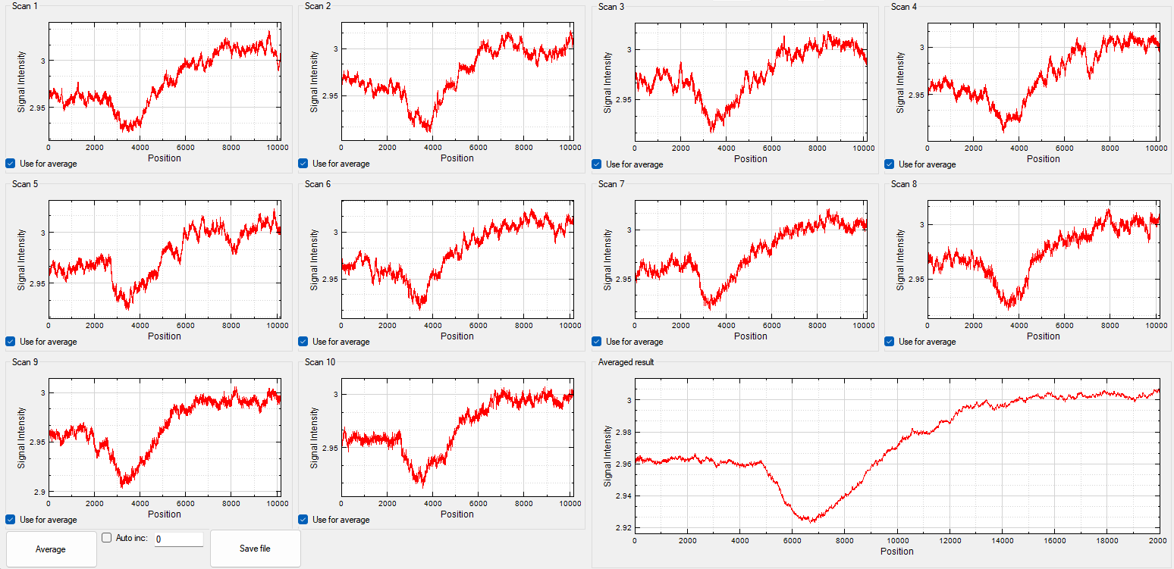
P8 Summary
Sometimes, the change of the files (resaving) before TxtShuffle / Nematicity (AveragedRot) is required. Some possible cases are:
Some individual scans have high noise \ unphysical features (AverageOverScansT helps with it)
Temperature –dependent measurement set (manual, old program versions) with different increment (CloneAndRenumber helps with it)
Video explanations are given in the videos
AverageOverScansT
CloneAndRenumber

